Slide 1

Car Dealership
Design Document
By
Sankalp – 1602-19-737-038

Slide 2

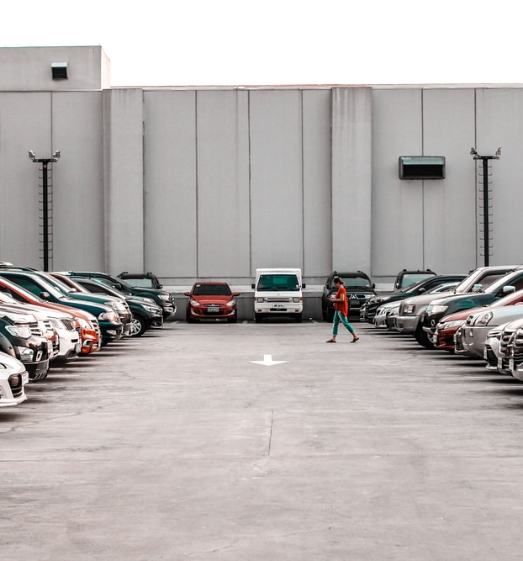
Features of the project:
User:
Register
Login
Check used vehicle's available with their pricing
Check maximum price given to a vehicle
Vehicles available for rent with their pricing
Manager:
Changing prices of used vehicles
Changing maximum prices of vehicles which sold
Changing prices of renting vehicle

Slide 3

Registration
Changing prices of used vehicles
Customer
Manager
Login
Changing maximum prices of vehicles which sold
Check used vehicles’ available with their pricing
Changing prices of renting vehicle
Check maximum price given to a vehicle
Vehicles available for rent with their pricing

Slide 4
Use case ID: UC01 Name: Registration Actors: Customer Description : Allows new customer to register for an account. Pre-conditions: None Post-conditions: An account is created if the customer is new. Main flow:
Customer | System
1. Enters personal details for registration.
 | 2. System check whether the user exists or not, if exist then creates an account, and if not then displays user already exist.

Slide 5
Use Case ID: UC02 Name: Login Actors: Customer Description: Allows registered customer to Login Pre-conditions: Customer should be registered with the system Post-conditions: Customer logs in and all the options are displayed on the screen Main Flow:
Customer | System
1. Gets logged in to the application
 | 2. System displays menu

Slide 6
Use Case ID: UC03 Name: Used vehicles' lists Actors: Customer and Manager Description: Check used vehicles’ availability with their pricing Pre-conditions: Customer should select relevant option from menu Post-conditions: System allows Customer to buy used vehicles Main flow:
Customer | System
 | 1. Displays list of used cars with their pricing updated by manager.
2. Selects a car and purchases it.

Slide 7
Use Case ID: UC04 Name: Check price Actors: Customer and Manager Description: Check maximum price given to a vehicle of the customer Pre-conditions: Customer should select relevant option from menu Post-conditions: System allows Customer to sell vehicles Main flow:
Customer | System
 | 1. Displays list of cars along with their maximum selling price updated by manager.
2. Selects his/her car and sell it.

Slide 8
Use Case ID: UC05 Name: Renting vehicle Actors: Customer and Manager Description: Vehicles available for rent with their pricing Pre-conditions: Customer should select relevant option from menu Post-conditions: System allows to rent vehicle Main flow:
Customer | System
 | 1. Displays the list of vehicle available for renting
2. Selects a car and rents it

